Slide 1
License Generation
2020/07/17 – Neo Kang

Slide 2
Preliminary
Purpose of this document is to show how to generate license on browser
Web address: https://”Server_PC_IP”/licensegenerate.php
Check PC IP via CMD command : ipconfig
Ex: https://10.50.3.43/licensegenerate.php (This is current server IP address)
Follow the setup step to get the license file
Simple Operation Guideline:
Make sure IP address can be connect
Support upload single or multiple ActivateCode.ac file (File name can be random)
Support download license file by ZIP file.
Need to click “Clean Folder” button after finished download the license file

Slide 3
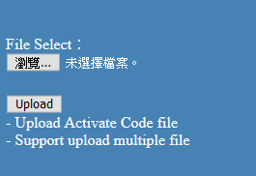
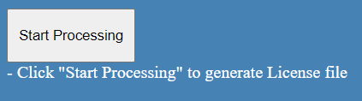
Detailed Steps(1/2)
Step#1, Click the “File Select” button to upload the ActivateCode.ac file
Step#2, Click “Start Processing” button to generate license file

Slide 4


Detailed Steps(2/2)
Step#3, After finished license generate, click “Download License file” button to get license file
Step#4, Click “Clean Folder” button to delete all license file and ActivateCode.ac in the specified folder .

